Slide 1
Network Types
LAN (Local Area Network)
MAN (Metropolitan area network)
WAN (Wide area network)
CAN (Campus area network)
PAN (Personal area network)
WLAN (Wireless local area network)
DAN (Disk area network)
SAN (Storage area network)

Slide 2
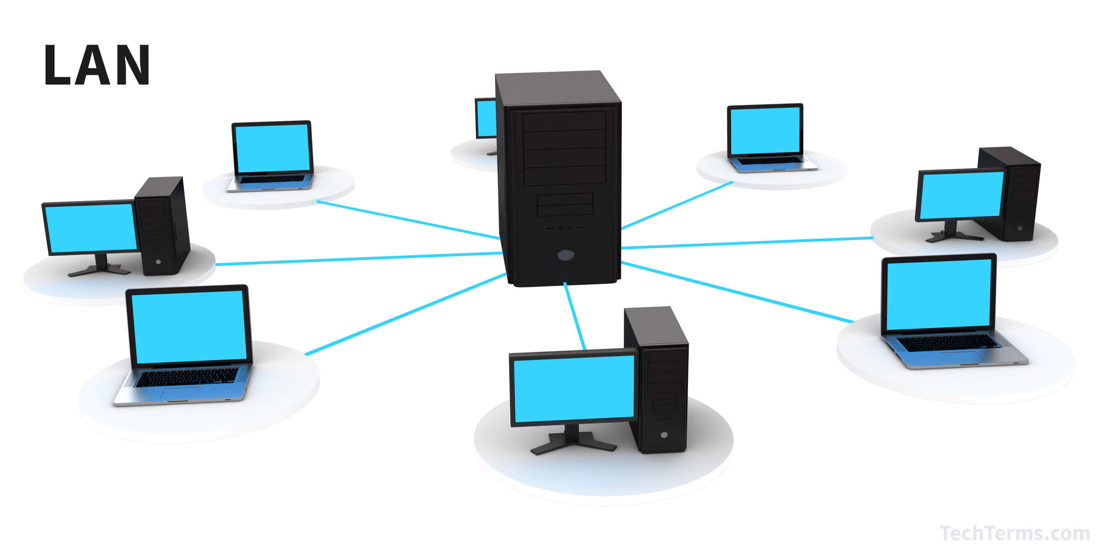
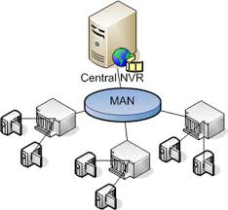
Local Area Network:
It is a group of systems associated in a relatively small area.
It connects devices in a limited geographical area using one or more hubs or switches.
Metropolitan Area Network
It is the network which interconnects large computer networks in which two or more computers are connected across a city.

Slide 3
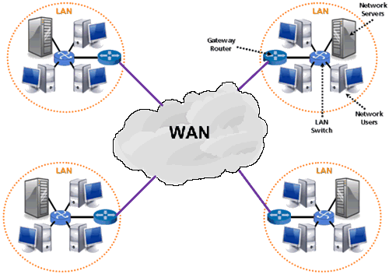
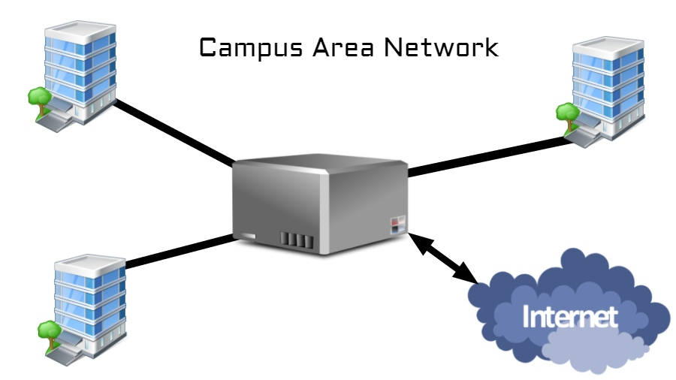
Wide Area Network
It provides network connectivity over large geographical areas between countries.
Campus Area Network
It is a network made up of an interconnection of local area networks within limited area.

Slide 4
Other Network Types
5. Personal Area Network
The smallest type of network you can currently use and the name comes from Personal Area Network.
6. Storage Area Network
It connects servers to data storage devices with the use of a specific technology.
7. Desk Area Network
It is a interconnection of computer devices using ATM (Asynchronous Transfer Mode)

